Slide 1
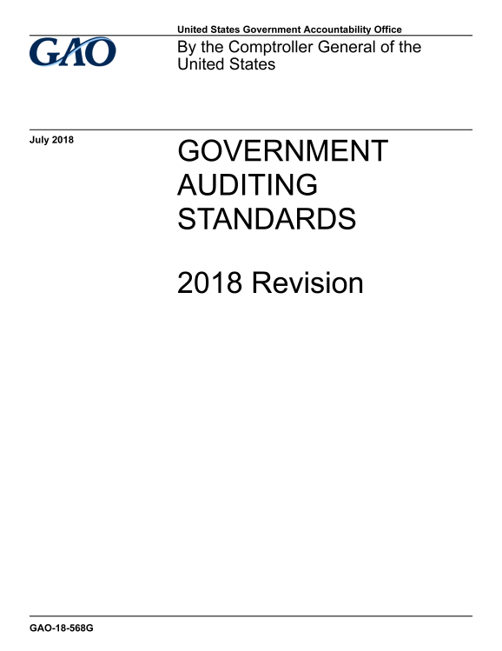
Update on the Developments in Government Auditing Standards
2018 Yellow Book Revision
Presentation for the Council of the Inspectors General on Integrity and Efficiency (CIGIE)
May 10, 2019

Slide 2
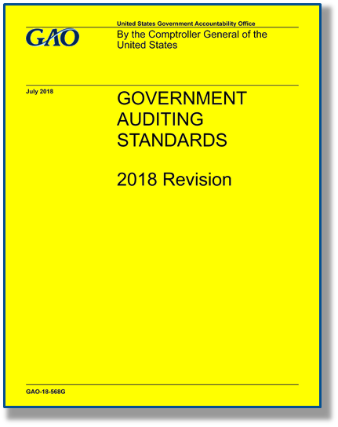
Session Objective
Provide a summary of revisions to the Yellow Book

Slide 3
Yellow Book Revision Process
Exposure draft was issued for public comment on April 5, 2017.
GAO received 95 comment letters with over 1,700 individual comments on the exposure draft.
The 2018 Revision was issued on July 17, 2018.

Slide 4
Summary of Key Changes from 2011 Revision
New format and organization
Common terms and definitions
Independence threats related to preparing financial statements
Updates to independence guidance
Competence of auditors
Guidance for CPE requirements
Competence of specialists
Peer review requirements

Slide 5
Summary of Key Changes from 2011 Revision
Quality control and monitoring of quality
Internal control: financial audits and examination engagements
Internal control: performance audits
New considerations for addressing waste
Standards for reviews of financial statements
Criteria for performance audits
Management assertions

Slide 6
New Format and Organization
Chapters are presented in a revised format that differentiates requirements from application guidance.
Chapters are reorganized and realigned.
Supplemental guidance from the appendix of the 2011 revision was either removed or incorporated into individual chapters.
Hard copy version is a larger size.

Slide 7
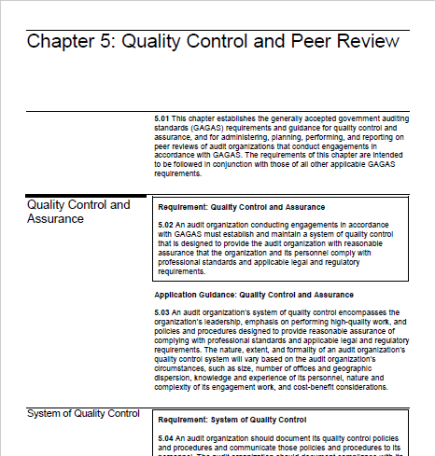
New Format and Organization

Slide 8
Common Terms and Definitions
Examples of types of Yellow Book users are addressed (para. 1.12).
Integrated audit added to the types of financial audits (para. 1.17b).
Descriptions of attestation engagements, reviews of financial statements, and performance audits are expanded (paras. 1.18-1.26).

Slide 9
Common Terms and Definitions (cont.)
Definition of common terms used in the Yellow Book are expanded.
Terms such as engaging party, audited entity, responsible party, and specialist (para. 1.27)
Added guidance that when terminology differs from that used at an organization subject to GAGAS, auditors use professional judgment to determine if there is an equivalent term (para. 1.27).
Added a glossary of terms.

Slide 10
Common Yellow Book Technical Assistance Questions
Example 1
Question:
Does an audit of a tribe's 401k plan need to be done in accordance with the Yellow Book?

Slide 11
Example 1
GAGAS Issue: Who or what determines whether an audit should be performed under Generally Accepted Government Auditing Standards (the Yellow Book)?
GAGAS Reference: 2011 Paragraph 1.06
2018 Paragraph 1.08

Slide 12
Example 2
Question:
When auditing an entity that received a Federal grant under the Uniform Grants Guidance, how should the recipient entity charge indirect costs?

Slide 13
Example 2
GAGAS Issue: What GAGAS requirements are relevant to specific single audit requirements?
GAGAS Reference: GAGAS requirements generally do not address issues at this detailed level. Instead, the Uniform Grants Guidance addresses more specific questions. Refer to the cognizant or oversight agency contact.

Slide 14
Independence Threats related to Preparing Financial Statements & Accounting Records
Nonaudit services performed by auditors related to financial statements and accounting records either:
Impair Independence
No change from 2011 Yellow Book (para. 3.87)
The auditor prepares financial statements in their entirety (para. 3.88).
OR
The auditor determines that a service related to preparing financial statements or accounting records is a significant threat (para. 3.93).
Document the threats and safeguards applied to eliminate and reduce threats to an acceptable level (para. 3.33).
OR
Decline to perform the service (para. 3.88).
Are Significant Threats
Are Threats
Evaluate threat and document evaluation (para. 3.90).
Typing, formatting, printing, binding: not likely significant (para. 3.95)

Slide 15
Independence Considerations for Preparing Accounting Records and Financial Statements

Slide 16
Safeguards Related to Nonaudit Services
Examples of safeguards for addressing threats to independence related to nonaudit services (para. 3.69):
not including individuals who provided the nonaudit service as engagement team members;
having another auditor, not associated with the engagement, review the engagement and nonaudit work as appropriate;
engaging another audit organization to evaluate the results of the nonaudit service; or
having another audit organization re-perform the nonaudit service to the extent necessary to enable that other audit organization to take responsibility for the service.

Slide 17
Nonaudit Services vs. Routine Activities
Routine activities are not considered nonaudit services (para. 3.70).
Examples include (paras. 3.70 & 3.71):
providing advice and responding to questions as part of an engagement, and
educating the audited entity on matters within the technical expertise of the auditors.

Slide 18
Additional Updates to Independence Guidance
Added application guidance to define management's “Skills, Knowledge and Experience” (SKE) an indicator is management’s ability to recognize a material error (para. 3.79).
Updated application guidance to clarify that certain services provided by government audit organizations would generally not create threats to independence allowability of certain functions such as investigations (para. 3.72).

Slide 19
Additional Updates to Independence Guidance (cont.)
Further explained the independence requirements of the auditor when the engaging party differs from the responsible party (para. 3.24).
Added guidance to address situations in which government auditors work in conditions that impair independence (para. 3.25).

Slide 20
Common Yellow Book Technical Assistance Questions
Example 3
Question:
Is there an independence threat related to an auditor’s preparation of financial statements for an audit client?

Slide 21
Example 3
GAGAS Issue: Are there any independence requirements in GAGAS that prohibit the auditors from preparing the client’s financial statements?
GAGAS Reference:
2011 Paragraphs 3.34, 3.50 - 3.52, and 3.59
2018 Paragraphs 3.73 – 3.82, 3.87 – 3.95, and 3.107

Slide 22
Example 4
Question:
An auditor’s prospective new client, who has never undergone an audit before, requested assistance with audit preparation. Can the auditor advise the client as to what documentation would be needed for review by the auditor?

Slide 23
Example 4
GAGAS Issue: Would helping the client in preparing for an audit pose a threat to the auditor’s independence necessary to conduct a GAGAS audit?
GAGAS Reference:
2011 Paragraphs 3.08, 3.13, 3.34, 3.40, and 3.41
2018 Paragraphs 3.27, 3.61, 3.64, 3.73, 3.74, 3.70, and 3.71

Slide 24
Competence of Auditors
Management assigns auditors to conduct an engagement who before beginning work on the engagement possess the competence needed for their assigned roles (para. 4.02).
Audit organizations consider the levels of proficiency needed for each role on the engagement:
Nonsupervisory,
Supervisory, and
Partner and director.
(paras. 4.09 and 4.10)

Slide 25
Guidance for CPE Requirements

Slide 26
CPE Requirements and Guidance
Removed the 4-hour GAGAS Qualification CPE requirement proposed in the exposure draft.
Added application guidance related to obtaining GAGAS specific CPE each time a new Yellow Book revision is issued (para. 4.19).

Slide 27
CPE Requirements and Guidance (cont.)
Similar to the 2011 Yellow Book, CPE requirements are:
(para. 4.16)
Refined lists of examples of topics and subjects that qualify for the 24 hour and 56 hour requirements (paras. 4.21 - 4.24).
CPE Hours | Subject Matter Categories of CPE
24 hours | Subject matter directly related to the government environment, government auditing, or the specific or unique environment in which the audited entity operates
56 hours | Subject matter that directly enhance auditors’ professional expertise to conduct engagements

Slide 28
Competence of Specialists
Engagement team should determine whether specialists are qualified and competent in their areas of specialization (para. 4.12).
External specialists are not subject to Yellow Book CPE requirements (para. 4.30).
Internal specialists who are not involved in planning, directing, performing engagement procedures, or reporting are not subject to Yellow Book CPE requirements (para. 4.30).
IT auditors are considered auditors and thus are subject to the CPE requirements (para. 4.13).

Slide 29
Common Yellow Book Technical Assistance Questions
Example 5
Question:
An employee of an audit organization was a college intern for 1.5 years and was then employed full time for the last .5 year of the Continuing Professional Education (CPE) reporting cycle. Does the employee’s college classwork apply toward the GAGAS CPE requirements?

Slide 30
Example 5
GAGAS Issue: What types of coursework can be counted toward an auditor’s GAGAS CPE requirements?
GAGAS Reference:
2011 Paragraph 3.76 and 3.77 and Guidance on GAGAS Requirements for Continuing Professional Education, 2005
2018 Paragraph 4.16, 4.21 – 4.24, and 4.32 – 4.36

Slide 31
Example 6
Question:
Can CPE hours used to fulfill the state board of accountancy’s accounting & auditing requirement be used to fulfill the 24-hour GAGAS CPE requirement?

Slide 32
Example 6
GAGAS Issue: What topics count for the 24-hour GAGAS CPE requirement?
GAGAS Reference:
2011 Paragraph 3.76 and 3.77 and Guidance on GAGAS Requirements for Continuing Professional Education, 2005: Paragraphs 17, 18, 23 and 24
2018 Paragraph 4.16 and 4.21 – 4.23

Slide 33
Peer Review Requirements
Peer review section differentiates requirements for those audit organizations affiliated with a recognized organization.
Yes
Audit organization affiliated with a recognized organization?
No

Slide 34
Peer Review Requirements
All audit organizations comply with GAGAS peer review requirements for:
Assessment of peer review risk (paras. 5.66 & 5.67),
Peer review report ratings (paras. 5.72 – 5.74), and
Availability of peer review report to the public (paras. 5.77 – 5.80).

Slide 35
Peer Review Requirements: Affiliated
Audit organizations affiliated with a recognized organization also comply with the respective organization’s
peer review requirements (para. 5.61).

Slide 36
Peer Review Requirements: Not Affiliated
Audit organizations not affiliated with a recognized organization also comply with additional GAGAS peer review requirements in areas including:
Peer review scope (para. 5.82),
Peer review intervals (para. 5.84),
Written agreement for peer review (para. 5.86),
Peer review team (para. 5.89),
Report content (para. 5.91), and
Audit organization’s response to the peer review report (paras. 5.93 – 5.94).

Slide 37
Peer Review Report Ratings
Pass
Pass with deficiencies
Communicate deficiencies in the peer review report
Fail
Communicate deficiencies and significant deficiencies in the peer review report

Slide 38
Common Yellow Book Technical Assistance Questions
Example 7
Question:
What if, due to unusual difficulty or hardship, an entity needs a peer review extension?

Slide 39
Example 7
GAGAS Issue: What is the process for receiving a peer review extension?
GAGAS Reference:
2011 Paragraph 3.97
2018 Paragraph 5.64

Slide 40
Quality Control
New specific requirements for quality control related to:
Annual independence affirmation (para. 5.09),
Undertaking engagements only if the audit organization has the capabilities, including time and resources, to do so (para. 5.12),
Consultation on difficult or contentious issues (para. 5.24),
Supervision and review of work (para. 5.36), and
Assigning an engagement partner or director to each engagement (para. 5.37).

Slide 41
Monitoring of Quality
New specific requirements for monitoring of quality related to:
Communication of monitoring sufficient to enable corrective actions (para. 5.44), and
Evaluation of deficiencies noted during monitoring (para. 5.45).

Slide 42
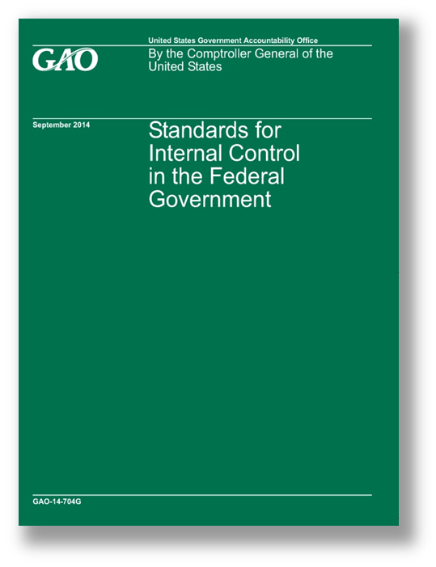
Internal Control: Financial Audits and Examination Engagements
Considering a comprehensive internal control framework such as Standards for Internal Control in the Federal Government or Internal Control – Integrated Framework can help auditors identify the cause of findings and develop recommendations. (paras. 6.18 & 7.20)

Slide 43
Elements of a Finding
Condition: the situation that exists.
Criteria: standards for what should be.
Cause: the explanation of why the condition deviates (if it does) from the criteria.
Effect: the actual or potential consequences of allowing the condition to persist.

Slide 44
Internal Control: Performance Audits
Auditors should document the significance of internal control to performance audit objectives (para. 8.39).
Internal control significant to audit objectives?
Yes
Document and Proceed
(See next slide)
No
Document
Determine, as applicable, for new or revised objectives

Slide 45
Internal Control: Performance Audits (cont.)
Internal control significant to audit objectives =
Obtain an understanding of internal control that is significant to the audit objectives (para. 8.40).
Assess and document the assessment of internal control to the extent necessary to address the audit objectives (para. 8.49).
Evaluate and document the significance of identified internal control deficiencies within the context of the audit objectives (para. 8.54).
Consider internal control deficiencies when developing the cause element of findings (para. 8.117).
Identify in the audit report which internal control components and principles are significant (para. 9.30).
Yes

Slide 46
Fraud, Waste, and Abuse
FRAUD
WASTE
ABUSE

Slide 47
New Considerations for Addressing Waste
Waste is the act of using or expending resources carelessly, extravagantly, or to no purpose.
Waste can include activities that do not include fraud and abuse and does not necessarily involve a violation of law.
Waste relates primarily to mismanagement, inappropriate actions, and inadequate oversight.
(paras. 6.21, 7.23, & 8.120)

Slide 48
Waste and Abuse
Auditor considerations related to waste and abuse are intended to be consistent.
Auditors are not required to perform procedures to detect waste or abuse.
Evaluating internal control in a government environment may include consideration of internal control deficiencies that result in waste or abuse.
(paras. 6.20, 7.22, & 8.119)

Slide 49
Standards for Reviews of Financial Statements
For auditors conducting reviews of financial statements in accordance with GAGAS, GAGAS incorporates AR-C, Section 90, Review of Financial Statements (para. 7.01).
2011 GAGAS only incorporated reviews performed under the Statements on Standards for Attestation Engagements (SSAE).
Reviews of interim financial information in connection with audited financial statements are conducted under AU-C 930, plus the additional GAGAS requirements for reviews of financial statements.
AR-C, Section 90, Review of Financial Statements is more general in nature and is not connected with audited financial statements.

Slide 50
Performance Audits Criteria Guidance
Added discussion of suitable criteria, including attributes and examples (paras. 8.17 – 8.19).
Suitable criteria are relevant, reliable, objective, and understandable and do not result in the omission of significant information, as applicable, within the context of the audit objectives.

Slide 51
Management Assertions
Yellow Book has an explicit statement that assertions are not required for performance audits (para. 8.14).
Assertions for examinations under AICPA attestation standards is a "hot topic".

Slide 52
Common Yellow Book Technical Assistance Questions
Example 8
Question:
If an audit organization that conducts performance audits obtains continuous access to the audited entity’s databases for purposes such as follow up on corrective actions, what are some GAGAS considerations?

Slide 53
Example 8
GAGAS Issue: Are there any independence or performance audit field work requirements in GAGAS that prohibit the auditors from obtaining continuous database access?
GAGAS Reference:
2011 Paragraphs 3.07, 3.14, 6.36, and 6.47
2018 Paragraphs 3.26, 3.30, 8.30, and 8.20

Slide 54
Effective Date
2018 Revision is effective for
- Financial audits, attestation engagements, and reviews of financial statements for periods ending on or after June 30, 2020, and
- Performance audits beginning on or after July 1, 2019.
Early implementation is not permitted.

Slide 55
Where to Find the Yellow Book
The Yellow Book is available on GAO’s website at:
www.gao.gov/yellowbook
For technical assistance, contact us at:
yellowbook@gao.gov
or call (202) 512-9535

Slide 56
Thank You
Questions?

